Slide 1
Working with Classes and Interfaces in Java
UNDERSTANDING JAVA CLASSES AND OBJECTS

Slide 2
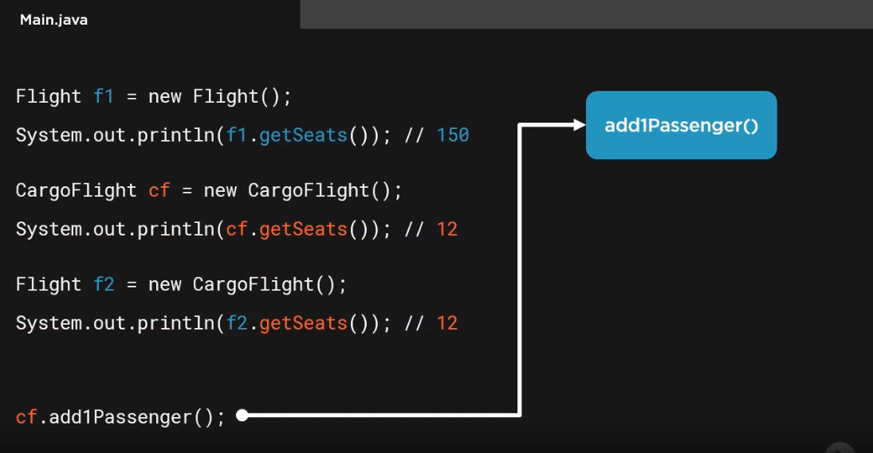

Slide 4
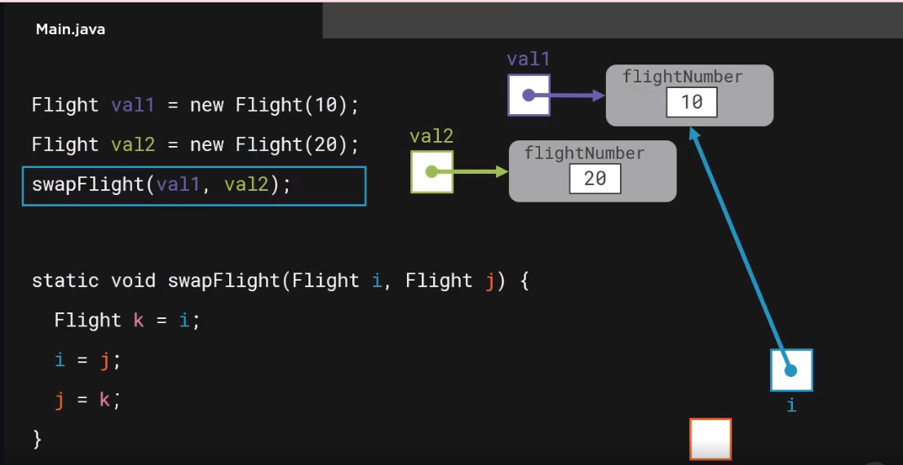

Slide 5
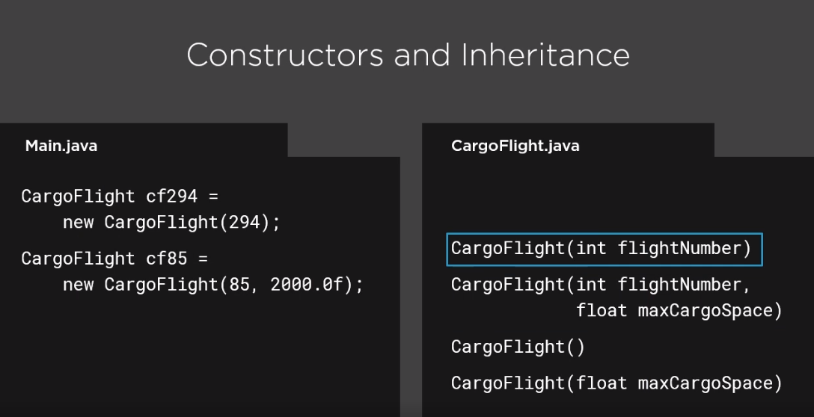

Slide 7


Declaring classes
Class members Working with objects
Encapsulation and access modifiers Field accessors and mutators
Overview

Slide 8



Java Is an Object-oriented Language
Objects encapsulate data, operations, and usage semantics
Allow storage and manipulation details to be hidden
Separates what is to be done from how it is done

Slide 9
A Class Is a Template for Creating Objects
Flight.java
class Flight {
// class members
}
Declared with class keyword followed by the class name
Body of the class is contained within brackets
Java source file name normally has same name as class

Slide 10

Classes
A class is made up of both state and executable code
Fields
Store object state

Slide 11
class Flight { int passengers; int seats;
Flight.java
}

Slide 12

Classes
A class is made up of both state and executable code
Fields
Store object state
Methods
Executable code that manipulates state and performs operations

Slide 13
class Flight { int passengers; int seats;
Flight.java
void add1Passenger() { if(passengers < seats)
passengers += 1;
}
}

Slide 14

Classes
A class is made up of both state and executable code
Fields
Store object state
Methods
Executable code that manipulates state and performs operations
Constructors
Executable code used during object creation to set initial state

Slide 15
class Flight { int passengers; int seats;
Flight.java
Flight() {
seats = 150;
passengers = 0;
}
void add1Passenger() {
if(passengers < seats)
passengers += 1;
}
}

Slide 16
passengers
0
seats
Flight nycToLv;
nycToLv = new Flight();
Flight slcToSf = new Flight();
nycToLv
150
slcToSf
passengers
0
seats
150
Using Classes
Use the new keyword to create a class instance (a.k.a. an object)
Allocates the memory described by the class, and runs the constructor
Returns a reference to the allocated memory

Slide 17
Understanding Classes as Reference Types
Flight flight1 = new Flight();
Flight flight2 = new Flight(); flight2.add1Passenger(); System.out.println(flight2.passengers); // 1
passengers
0
seats
flight1
150
passengers
flight2
0
seats
150

Slide 18
Understanding Classes as Reference Types
Flight flight1 = new Flight();
Flight flight2 = new Flight(); flight2.add1Passenger(); System.out.println(flight2.passengers); // 1
flight1
passengers
12
seats
150
flight2 = flight1;
System.out.println(flight2.passengers);
// 0
passengers
flight1.add1Passenger();
flight1.add1Passenger();
flight2
1
seats
150
System.out.println(flight2.passengers); // 2

Slide 19


Encapsulation and Access Modifiers
The implementation details of a class are generally hidden
This concept is known as encapsulation
Java uses access modifiers to achieve encapsulation

Slide 20
Basic Access Modifiers
Modifier | Visibility | Usable on Classes | Usable on Members
No access modifier | Only within its own package (a.k.a. package private) | Y | Y
public | Everywhere | Y | Y
private | Only within the declaring class | N* | Y
* As private applies to top-level classes; private is available to nested-classes

Slide 21
Applying Access Modifiers
Main.java
Flight.java
public class Flight {
private int passengers; private int seats;
public Flight(){...}
public void add1Passenger(){...}
Flight flight1 = new Flight();
System.out.println( flight1.passengers);//ERROR!!
flight1.add1Passenger();
}

Slide 22
public class Flight {
// other members elided for clarity public void add1Passenger() {
Flight.java
if(passengers < seats) passengers += 1;
else
handleTooMany();
}
private void handleTooMany() { System.out.println(“Too many”);
}
}

Slide 23
Applying Access Modifiers
Main.java
Flight.java
public class Flight {
private int passengers; private int seats;
public Flight(){...}
public void add1Passenger(){...} private void handleTooMany(){...}
}
Flight flight2 = new Flight();
flight2.handleTooMany();//ERROR!! flight2.add1Passenger();

Slide 24
Special References
this
Implicit reference to current object Useful for reducing ambiguity Allows an object to pass itself
as a parameter
null
Represents an uncreated object
Can be assigned to any reference variable

Slide 25
Special Reference: this
public class Flight {
private int passengers; private int seats;
// other members elided for clarity public boolean hasRoom(Flight f2) {
int total =
this.passengers
+ f2.passengers;
return total <= seats;
}
}

Slide 26
Special Reference: null
Flight | lax1 = new | Flight();
Flight | lax2 = new | Flight();
// add | passengers | to both flights
Flight lax3 = null;
if(lax1.hasRoom(lax2))
lax3 = lax1.createNewWithBoth(lax2);
// do some other work if(lax3 != null)
System.out.println(“Flights combined”);

Slide 27



Field Encapsulation
The specific fields a class uses to manage data values is generally considered to be an implementation detail
In most cases these details should not be directly accessible outside the class
Use methods to control field access

Slide 28


Accessors and Mutators
Use the accessor/mutator pattern to control field access
Accessor retrieves field value
Also called getter Method name: getFieldName
Mutator modifies field value
Also called setter Method name: setFieldName

Slide 29
class Flight { private int seats;
Flight.java
// other members elided for clarity
public int getSeats() { return seats;
}
public void setSeats(int seats) {
this.s
eats
= seats;
}
}

Slide 30
Accessors and Mutators
Main.java
Flight slcToNyc = new Flight(); slcToNyc.setSeats(200); System.out.println(slcToNyc.getSeats());
200

Slide 31
Class
- Template for creating objects
Summary
Object
- Instance of a class
Classes are reference types
Class variables simply hold a reference
Instances created with new keyword
Multiple variables can reference the same instance

Slide 32
Fields
- Store object state
Summary
Methods
Executable code
Manipulate state
Perform operations
Constructors
Executable code
Runs during object creation
Sets initial state

Slide 33
Summary
this
- Implicit reference to current object
null
- Represents an uncreated object

Slide 34
Access modifiers
Control class visibility
Control member visibility
Enable encapsulation
Summary
Fields not normally directly accessible
Use methods to provide access
Accessors retrieve field values
Mutators modify field values

